Slide 1
Project 1
Based on a list of DE miRNAs in different colorectal cancer cell lines, further investigate their biological significance by:
Filtering statistically significant DE miRNAs(RQ>2 and p-value≤0.05 for up-regulated miRNAs; RQ<0.5 and p-value≤0.05 for down-regulated miRNAs)
Possible Comparisons
SW48 vs CACO2 | HCT116 -HT29- SW48 (Biological group 1) vs Caco2-LS174T (Biological group 2)
Up-reg miRNAs n=49 | Up-reg miRNAs n=26
Down-reg miRNAs n=3 | Down-reg miRNAs n=14
Analysis of target mRNAs (es. TarBase, https://diana.e-ce.uth.gr/tools)
Pathway analysis and functional enrichment analysis (es. mirPath, https://diana.e-ce.uth.gr/tools)
Analysis of interaction networks (focus on Sonic-Hedgehog (Hh) pathway)
.......

Slide 2
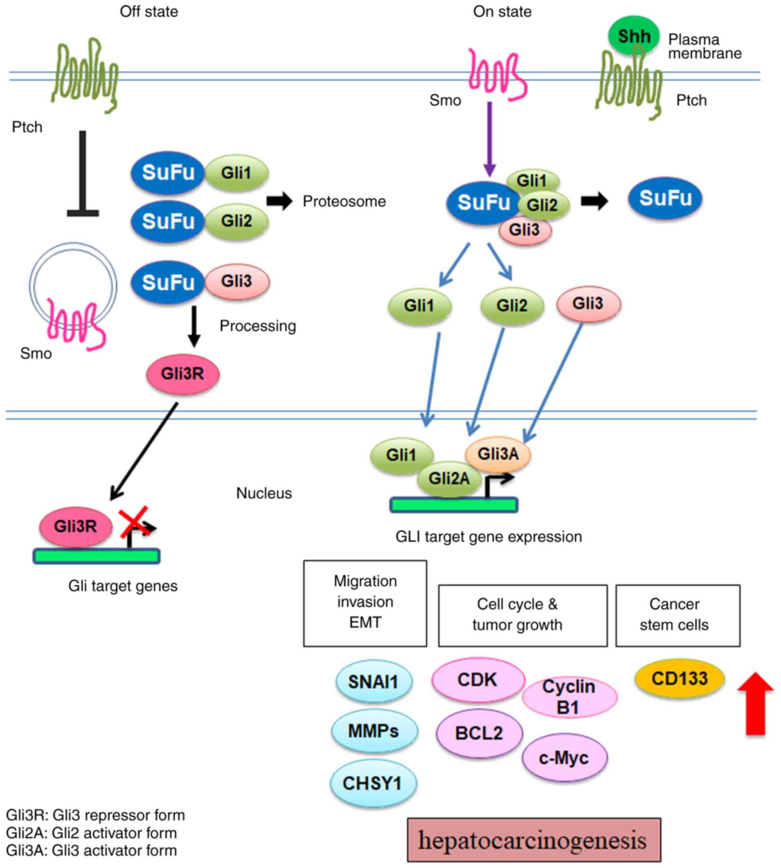
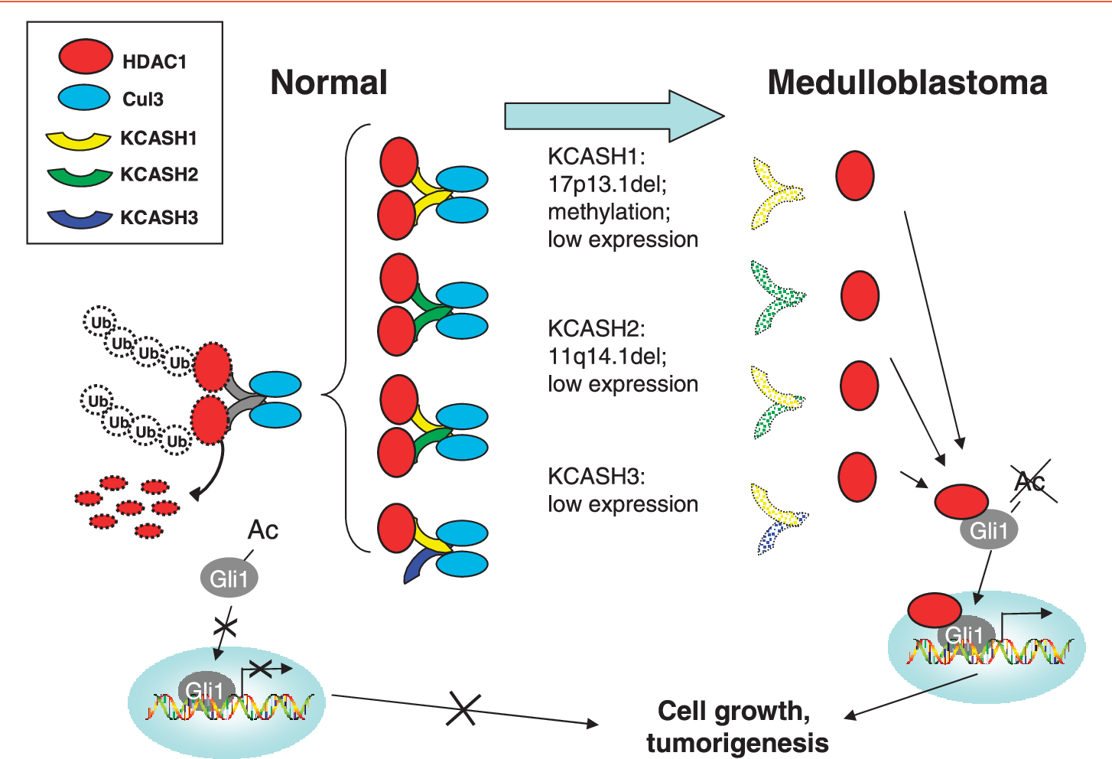
Sonic-Hedgehog (Hh) pathway plays a crucial role in embryonic development, tissue differentiation and staminality.
Altered Hh signaling is involved in different cancer types
Gli1/2/3, final Hh effectors, are the most studied factors (oncogenes)
KCASH1/2/3 overexpression was demonstrated to suppress Hh pathway and tumor cell proliferation (tumor suppressor genes)
De Smaele, Neoplasia 2011

Slide 3
Comparison
SW48 vs CACO2 | HCT116 -HT29- SW48 (Biological group 1) vs Caco2-LS174T (Biological group 2)
Up-reg miRNAs n=49 | Up-reg miRNAs n=26
Down-reg miRNAs n=3 | Down-reg miRNAs n=14
Based on the activation of Hh signaling pathway KCASH2-mediated: | Based on the specific expression of KCASH2 gene:
SW48 (Hh-dependent) vs CACO2 (Hh-independent) | HCT116 -HT29- SW48 (KCASH2 down) vs Caco2-LS174T (KCASH2 up)

